Slide 1
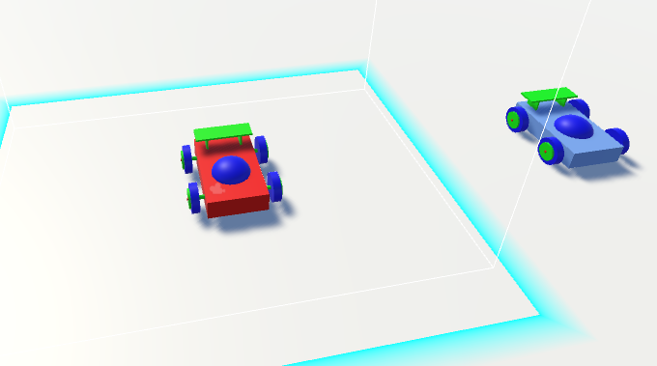
Mimic vr
A virtual reality simulation for robotics

Slide 2
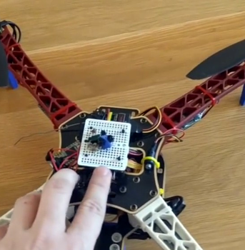
Background
HTC Vive Light house tracking
Open source Vive Tracker Technology
Drone and Robot actuation control through Vive
Tele-operated and Crime Scene Investigation Robots

Slide 3
Concept
Autonomous Agents utilizing VR tracking for navigation
Simulation and data recording from virtualized robot actuation
Response time and accuracy of path commands
How much can VR controlled robots Mimic Human movement?
Can a benchmark be used to measure movement accuracy?

Slide 4
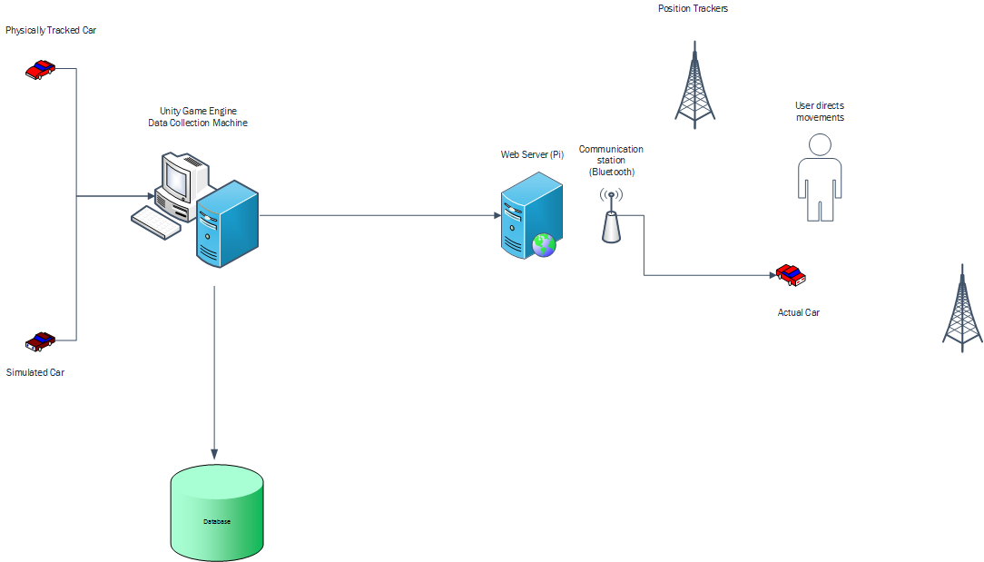
Architecture

